Slide 1

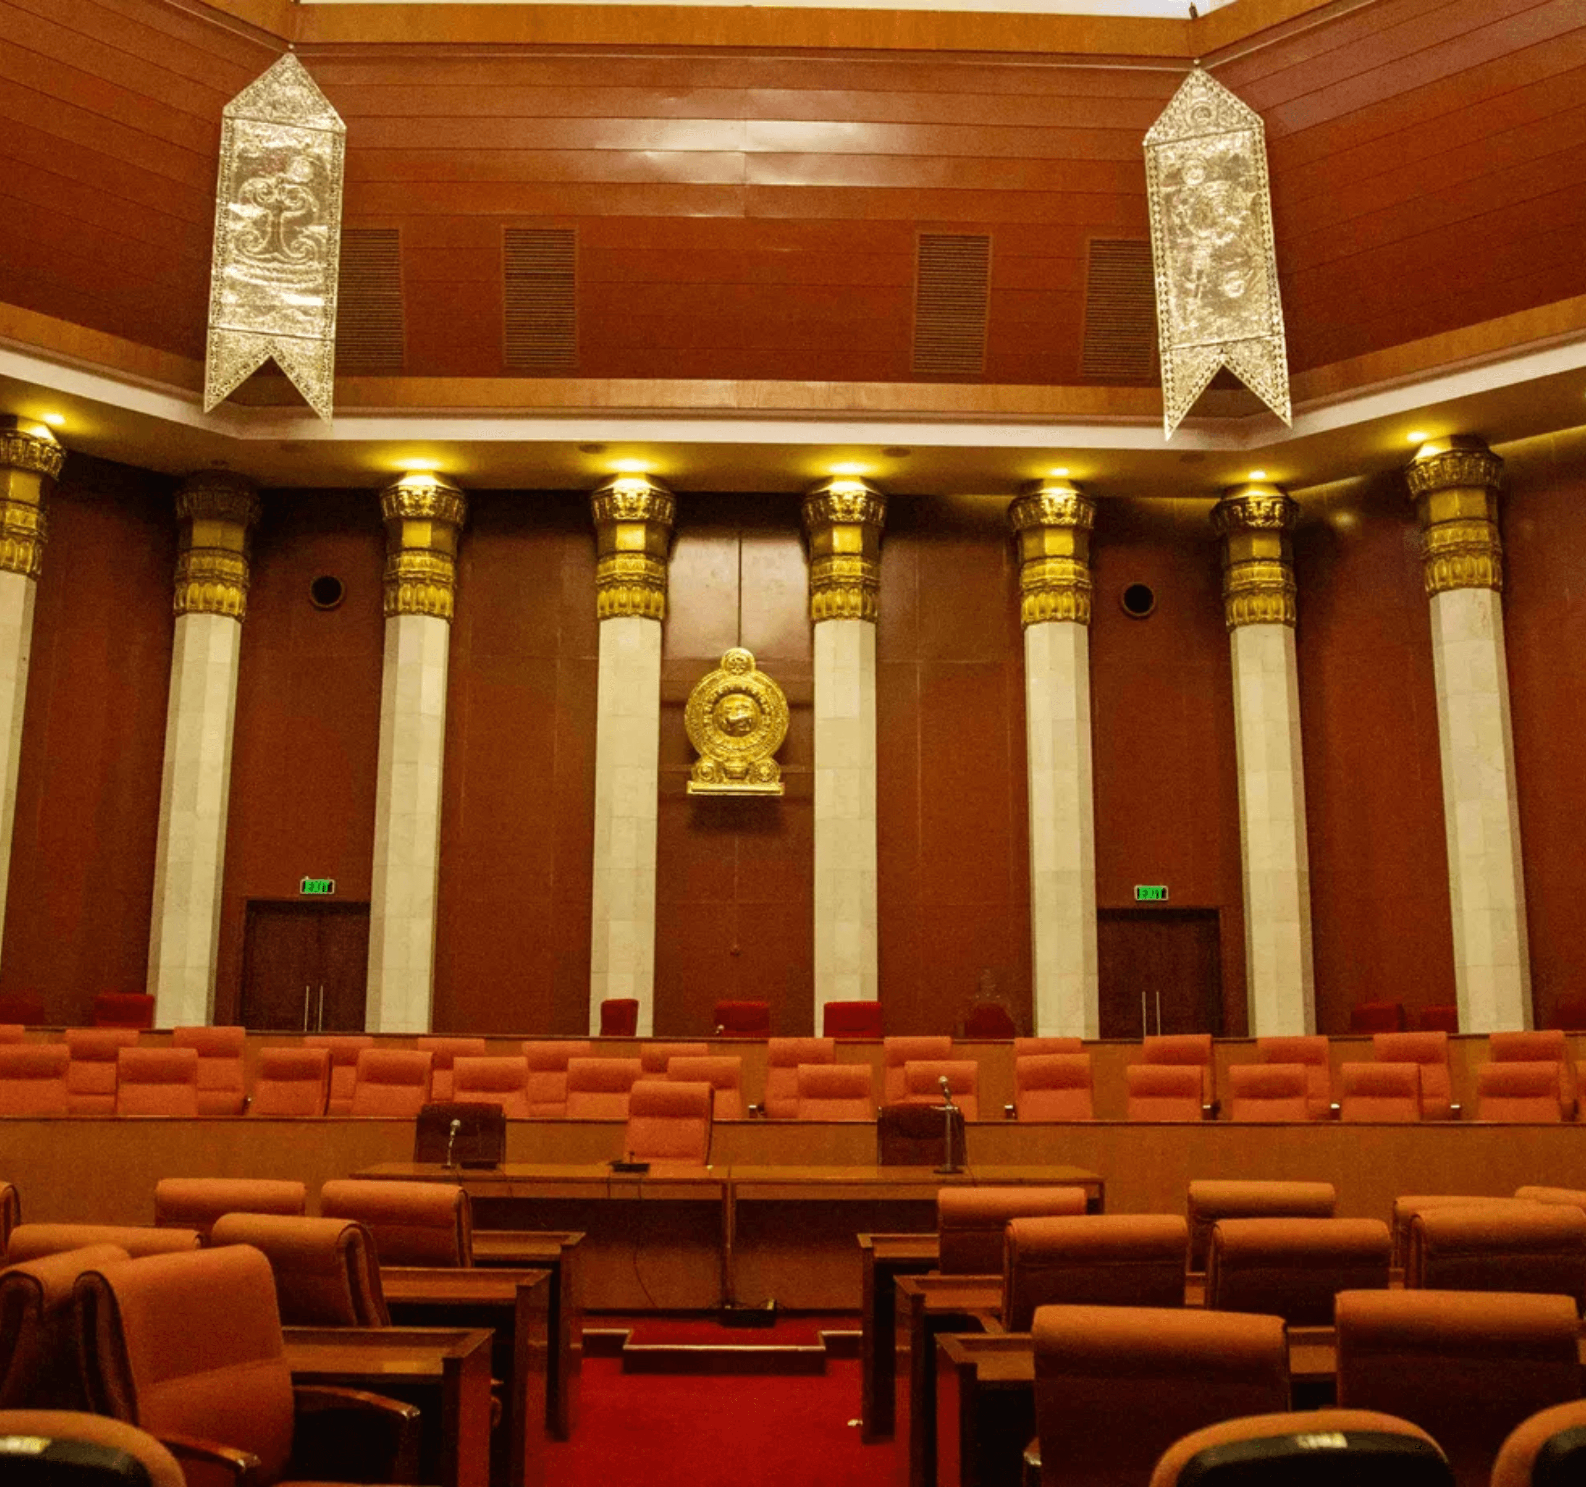
Geo-Forensic Scene Intelligence
Lawyer-Led Spatial Documentation for Criminal & Civil Proceedings
Sri Lanka

Slide 2

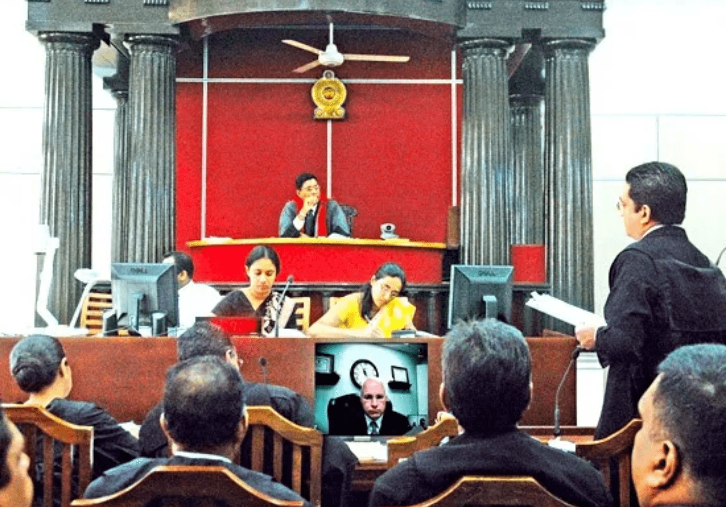
Addressing the Gap in Spatial Evidence
01
Courts decide based on clarity of facts, yet many cases suffer due to poor spatial explanation.
02
Site visits are often manual, memory-based, and difficult to reconstruct later in proceedings.
03
Standard documentation often lacks the visual precision required for complex scene intelligence.
NOTE: This service improves explanation and visualization — it does not alter underlying evidence.

Slide 3

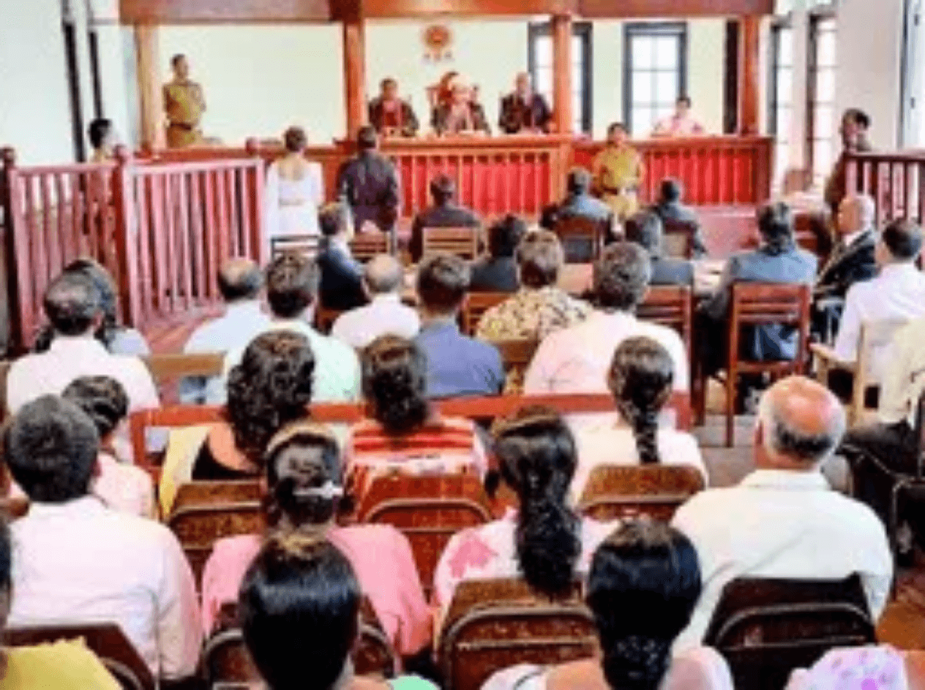
The Critical Role of Legal Professionals
Decision Authority
Scope Definition
Lawyers identify specific spatial elements that require visual clarification for the court.
Lawyers define the precise boundaries and limits of the documentation process.
Visual Control
Direct Oversight
Lawyers maintain full command over how and when visuals are introduced in proceedings.
Service operates strictly through legal professionals. No independent court submissions.
NO DIRECT CLIENT, POLICE, OR COURT ENGAGEMENT WITHOUT EXPLICIT LAWYER INSTRUCTION

Slide 4

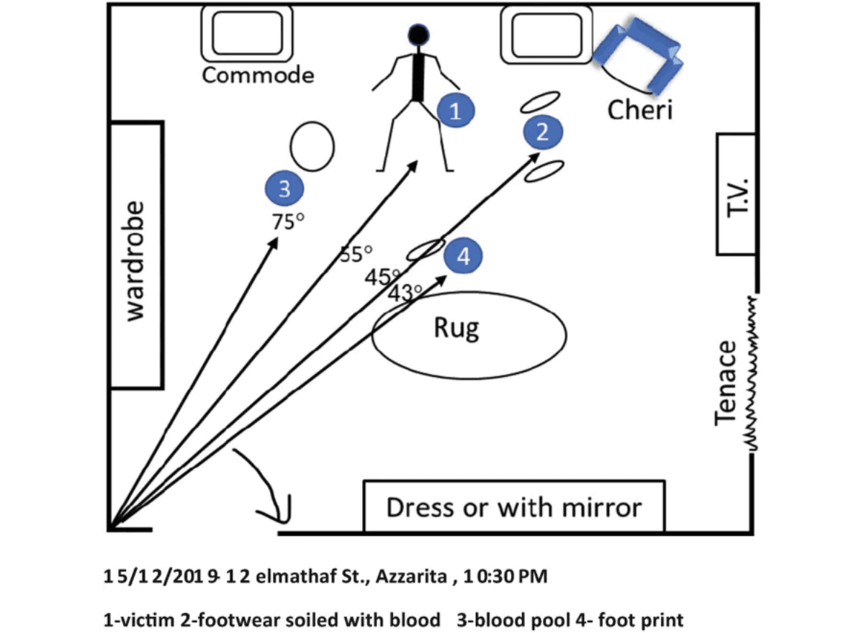
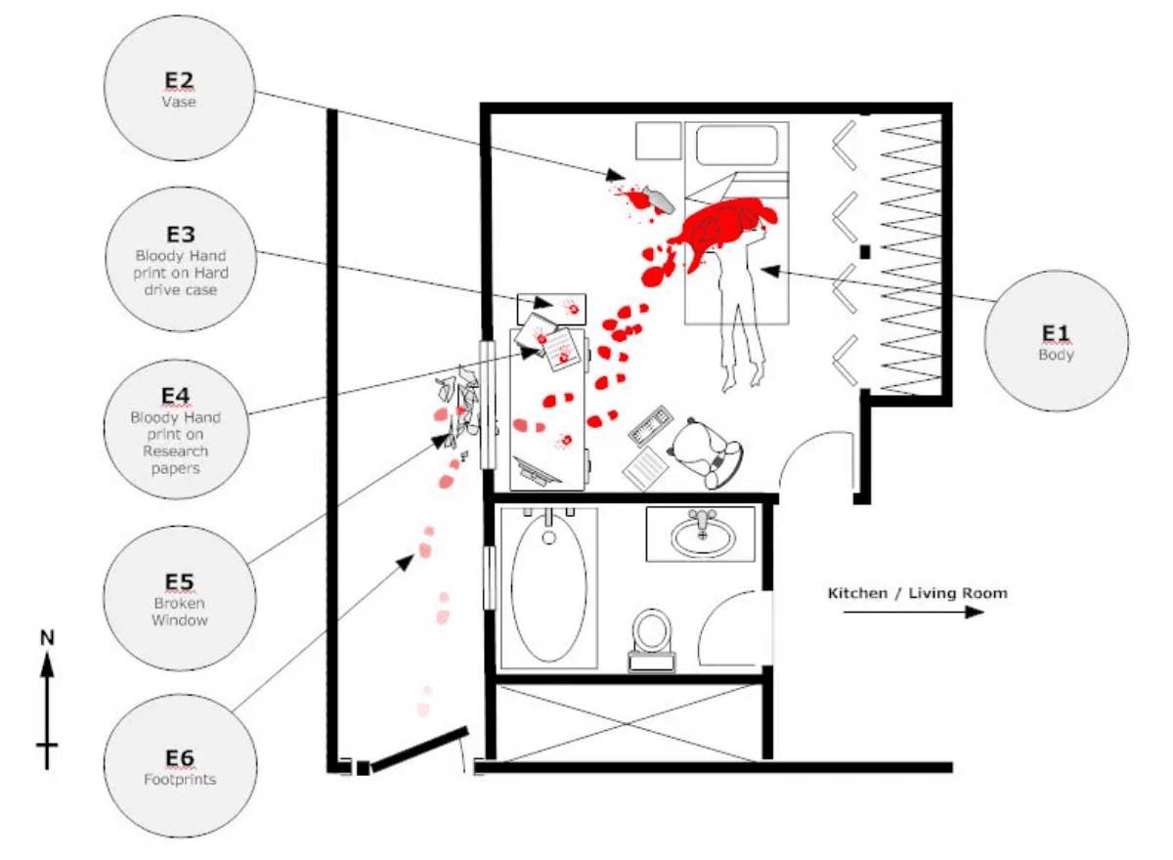

Delivering Clear, Non-Technical Exhibits
Scene Location Maps
Professional orientation and access mapping of incident sites.
Spatial Diagrams
Accurate visual data on distance, direction, and visibility.
Sequence Visuals
Spatial Orientation
Scene Layout
Mapping movement and time-flow for event reconstruction.
❌ NO TECHNICAL JARGON
❌ NO INTERPRETATION OF FACTS
Complex Movement Reconstruction

Slide 5

Integration with Sri Lankan Practice
Documentation Support
Legal Application
Procedural Fit
Complements and supports official police scene records.
Bail Hearings: Clarifying scene context for early relief.
Fully compatible with existing Sri Lankan court procedures.
Converts raw field observations into structured, clear visuals.
Trial Explanation: Visualizing complex spatial evidence.
Designed to bridge the gap between scene reality and judicial record.
Appeal Review: Reconstructing scenes for higher courts.
A Seamless Extension of Professional Legal Practice

Slide 6

Ethical Safeguards & Legal Integrity
Core Mandate
No Change to Evidence
No Influence on Witnesses
Prioritizing transparency and evidentiary standards to ensure judicial trust and professional accountability.
The physical state and integrity of the scene and evidence remain completely untouched.
Documentation is strictly objective and does not shape or suggest testimony.
No Opinions or Conclusions
Fully Auditable & Transparent
We provide factual documentation only, not expert opinions, judgments, or interpretations.
All processes and data captures are open to professional scrutiny and legal review.
🛡️ Professional Documentation Service Only

Slide 7

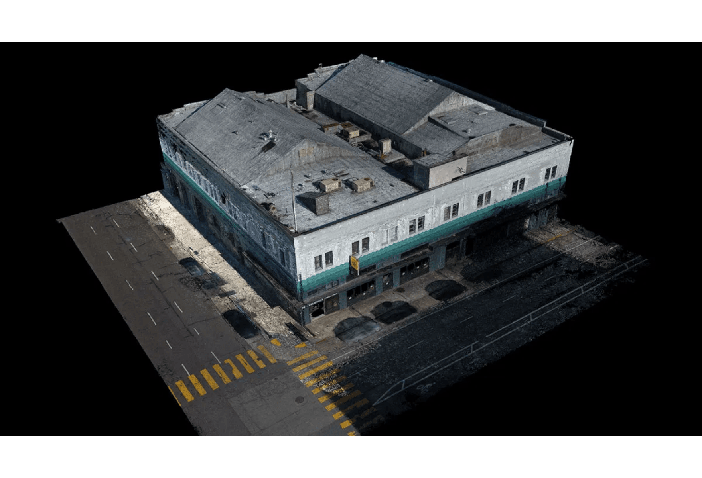
Professional Engagement Workflow
01
Identification
Lawyer identifies a specific need for spatial clarity in a case.
02
Formal Request
A formal professional instruction is issued to the service provider.
03
Data Capture
Scene data is professionally captured or existing records are reviewed.
04
Visual Preparation
Documentation is prepared according to the lawyer's defined scope.
05
✔ Lawyer remains in full control of the narrative.
Legal Utilization
The lawyer uses the material for explanation in court proceedings.
✔ No independent court submissions are made.

Slide 8

Investment and Fee Structure
Service Category
Description
Professional Fee
Institutional Setup
Legal alignment, SOP validation, and senior lawyer consultations. (One-time / Annual)
LKR
250,000 – 400,000
Case-Based Mapping
Geo-forensic scene mapping and preparation of court-ready visual exhibits.
LKR
15,000 – 30,000
Advanced Visualization
Timeline reconstructions and multi-layer movement visuals. (Optional Add-on)
LKR
25,000 – 50,000
All fees are professional charges for documentation services and are independent of case outcomes.

Slide 9

Annexure A: Formal Fee Schedule & Terms
Professional Scope
Engagement Terms
Fees relate exclusively to the production of professional spatial documentation and visual exhibits.
All services are payable per engagement as per the formal professional request issued by the instructing lawyer.
No legal advice, investigative authority, or expert testimony is included in this documentation service.
Institutional setup fees are billed annually or as a one-time setup cost depending on the framework agreement.
Outcome Independence
This document is intended for formal record-keeping and professional reference within the legal framework of Sri Lanka.
Professional fees are fixed for the work performed and are entirely independent of case outcomes or judicial decisions.
Official Documentation Service Terms • Confidential & Professional

Slide 10

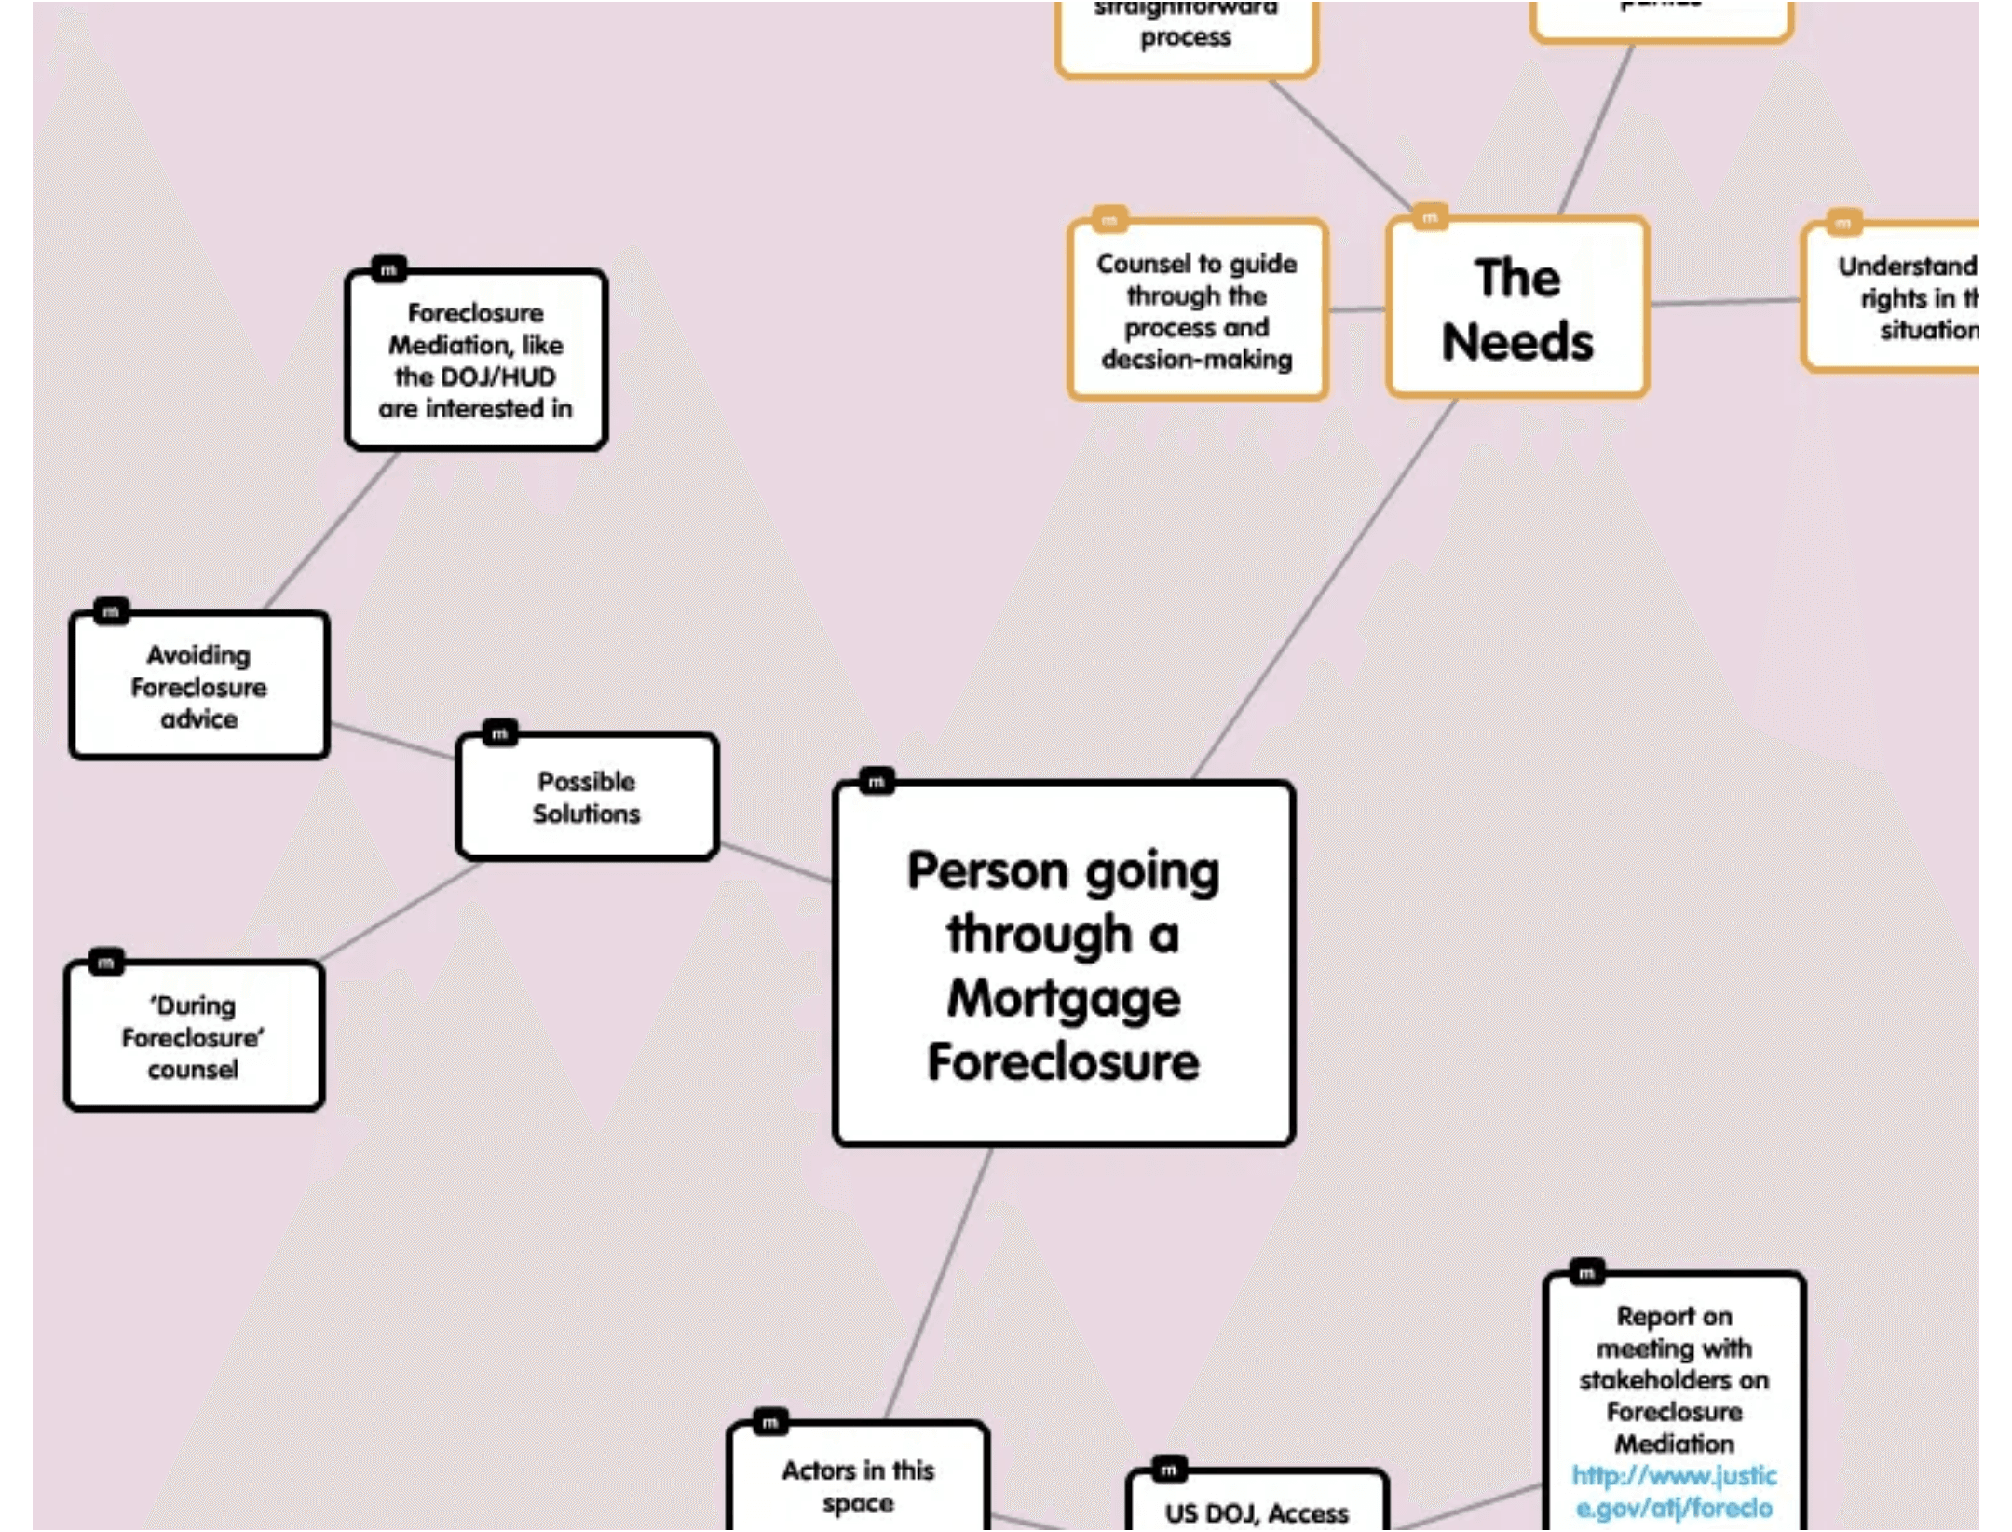
A Unique Standard in Sri Lanka
Lawyer-Led, Not Tech-Led
Technology serves the legal strategy, ensuring every visual is grounded in judicial requirements.
Judicial Optimization
Designed specifically for the understanding of judges and court officials in the Sri Lankan context.
Strategic Service Integration
The Ethical Foundation
Built on a foundation of legal trust, spatial expertise, and strict ethical discipline.

Slide 11

Strategic Roadmap and Next Steps
01
Senior Lawyer Feedback
Engaging with leading legal professionals to refine service protocols and ensure alignment with judicial expectations.
02
Identification of Pilot Cases
Selecting initial criminal and civil proceedings to demonstrate the value of spatial documentation in Sri Lankan courts.
03
Controlled Rollout
Gradual expansion of services to ensure quality control, ethical compliance, and professional excellence.
04
Institutional Recognition
Working toward formal acceptance and recognition within the legal and judicial framework of Sri Lanka.
Advancing Judicial Clarity Through Spatial Intelligence

